Slide 1
Global median filtering forensic method based on Pearson parameter statistics

Slide 2
CNN Based Detector

Slide 3
Pearson Parameter ‘𝓚’
Pearson system of distributions is characterised by the parameter κ
which is defined as the polynomial ratio of skewness and kurtosis.

Slide 4

Skewness(S) and Kurtosis(K)
Here. μ2, μ3 and μ4 are second, third and fourth centralised moments, respectively.

Slide 5
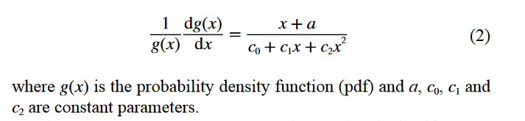
Derivation of Parameter 𝓚
Generation of unimodal probability distributions can be achieved by solving the differential equation

Slide 6

Equation Generated

Slide 7
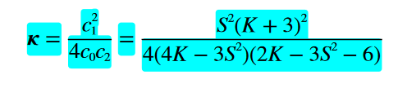
Final Equation

Slide 8
Streaking Effect.
The extent of dependence varies with the size of the window used and the distance between pixels. This effect is known as streaking effect.

Slide 9
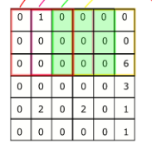
SRV(Single Residual Value)
A block with single residual value referred to as SRV block.

Slide 10
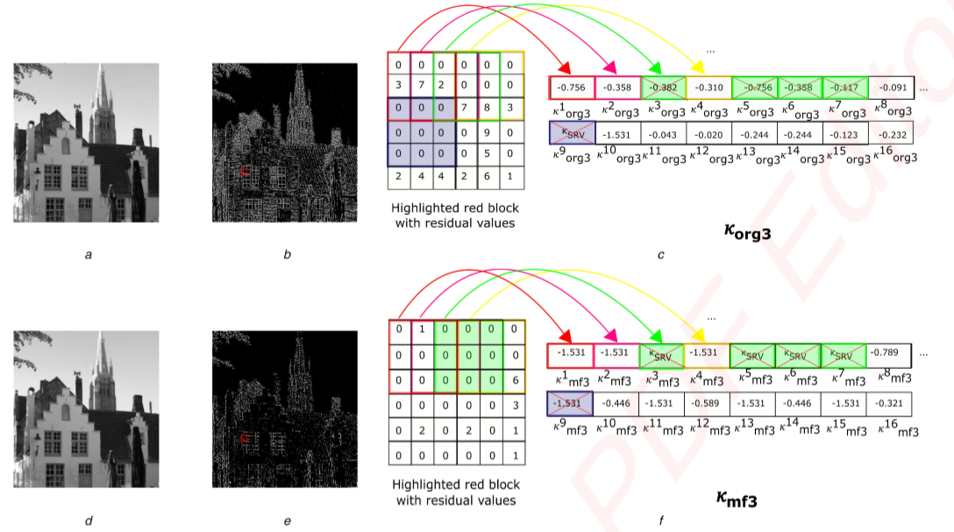

Slide 11
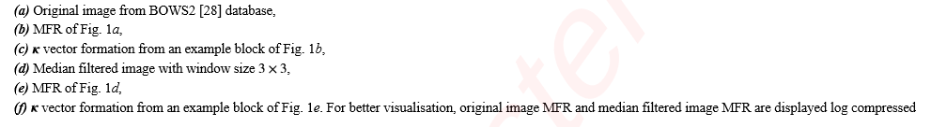

Slide 12
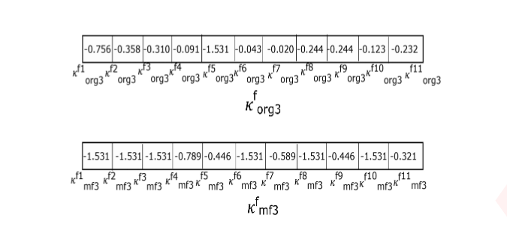

Slide 13
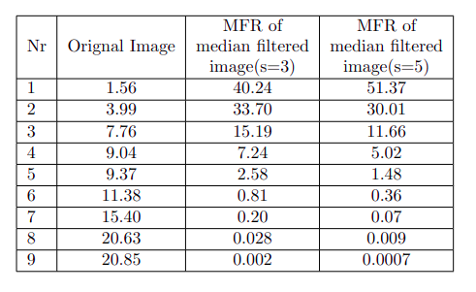
𝜿 analysis of distinct residual values in blocks
Streaking effect is responsible for decrease in number of distinct residual values in sliding blocks after median filtering
Average percentage (%) of distinct residual value blocks in the UCID database original images MFR
(ORG_IMG_MFR) and median filtered images (s = 3 and s = 5) MFRs (MF3_IMG_MFR and MF5_IMG_MFR)

Slide 14
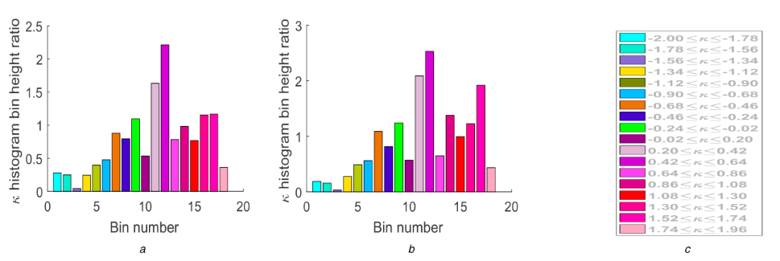
Original image MFRs to corresponding 3x3 median filtered images MFRs
Original image MFRs to corresponding 5x5 median filtered images MFRs
𝜿 range for different color blocks

Slide 15
Novel Feature Set
23 Distinguishing Features
𝜿 histogram bin height
Moments of block 𝜿 distribution
Count of SRV blocks

Slide 16

𝜿 histogram bin height
𝜿 histogram bin height are utilised as intrinsic fingerprints
denotes the ith bin of the 𝜿 vector histogram

Slide 17





Representation of
where
Total number of non-SRV blocks
Center of ith bin in 𝜿 histogram
Width of the ith bin in 𝜿 histogram

Slide 18


Moments of block 𝜿 distribution
where denote mean , variance , skewness and kurtosis of 𝜿 vector

Slide 19
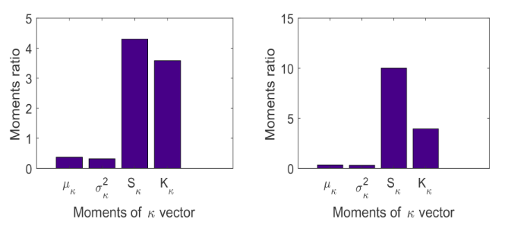


Bar plots of the ratio of average of the first four moments

Slide 20


Count of SRV Block
Where B denotes number of SRV blocks in image MFR and

Slide 21
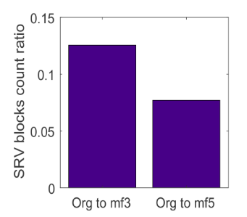
Ratio of the average of SRV block count , 3x3 median filtered to original , 5x5 median filtered MFR

Slide 22
Composite Feature Set

